Slide 1

Topic 5 – Cloud Infrastructure Management
Managing the Invisible Backbone of the Cloud

Slide 2
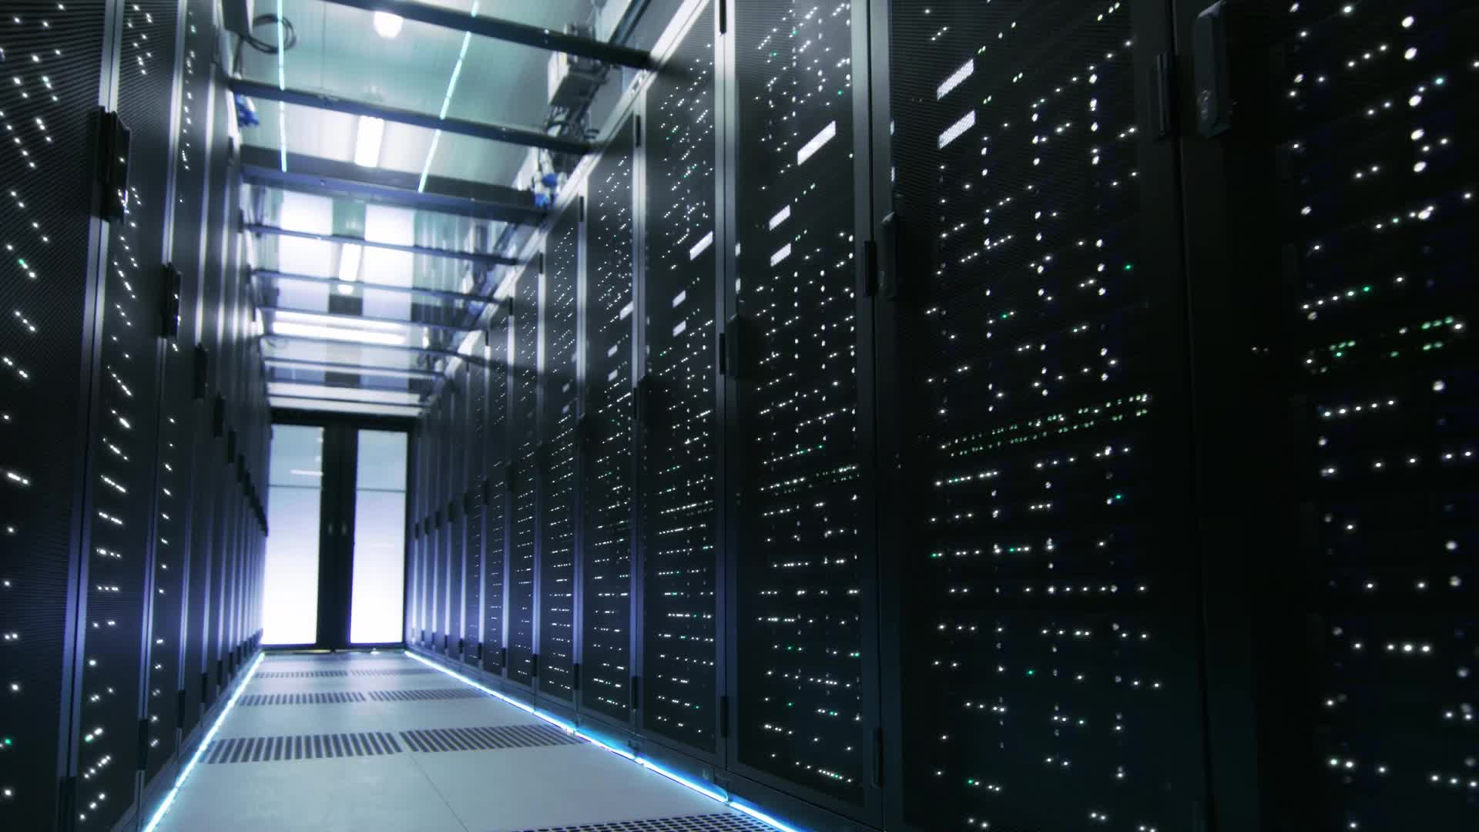
Introduction to Cloud Infrastructure
Cloud infrastructure includes:
Compute (VMs, containers)
Storage (block, object, file)
Network (virtual switches, routers)
Managed via web portals or APIs
Think of it like renting a fully furnished apartment. You don’t own the building (hardware), but you get everything you need inside (VM, storage, etc.)

Slide 3

Why Cloud Infrastructure Management Matters
Ensures resources are:
Available
Secure
Efficient
Prevents downtime and optimizes cost
Real-life example: Netflix uses cloud infrastructure to stream to millions. Without solid management, you'd be watching a spinning buffer wheel all day.

Slide 4

What is a Virtual Infrastructure Manager (VIM)?
- Software that manages virtualized resources in a cloud
Examples: OpenStack, VMware vSphere, Proxmox, Eucalyptus
Acts as the “invisible caretaker” of virtual resources

Slide 5
Core Features of a VIM
Provisioning VMs
Networking configuration
Storage management
Resource scheduling
Monitoring and logging
APIs for automation

Slide 6
Example – OpenStack as a VIM
Open-source VIM
Modular: Nova (compute), Neutron (network), Cinder (storage)
Scalable and customizable

Slide 7
VMware vSphere as a VIM
Enterprise-grade
Intuitive GUI
Integration with other VMware tools (vCenter, vSAN)

Slide 8
Feature Comparison of VIMs
Feature | OpenStack | VMware vSphere | Proxmox
Open-source | ✅ | ❌ | ✅
GUI | Moderate | Excellent | Good
Enterprise support | Moderate | Excellent | Moderate
Scalability | High | High | Medium

Slide 9
Advantages of Using Virtual Machines
Isolation between workloads
Better utilization of hardware
Snapshot & rollback
Disaster recovery
Portability

Slide 10
Purpose of Virtual Machines
Run multiple OS on one physical machine
Simulate different environments
Cost-efficient deployment

Slide 11
Benefits of Virtual Machines in Cloud
Scalability: Clone in minutes
Load balancing: Migrate VMs based on demand
Maintenance: Update without downtime

Slide 12
Opportunities in Cloud Infrastructure Management
Automated scaling
Multi-cloud strategy
AI-based resource optimization
Integration with DevOps (CI/CD)

Slide 13

Challenges in Cloud Infrastructure
Vendor lock-in
Complex configurations
Latency issues
Skills gap

Slide 14
Security Issues in Virtual Infrastructure
Hypervisor attacks
VM escape
Insecure APIs
Data breaches

Slide 15

Performance Issues
Overprovisioning
VM sprawl (too many unused VMs)
Resource contention

Slide 16

Cost Management Challenges
Pay-per-use can spiral
Unused VMs add cost
Lack of visibility = billing shocks

Slide 17
Disadvantages of Virtual Machines
Slower than containers
Resource overhead
Complex network setups
Longer boot times

Slide 18
How to Overcome the Challenges
Use automation tools (Ansible, Terraform)
Monitor usage and set alerts
Train staff continuously
Use hybrid cloud wisely

Slide 19

Cloud Management Best Practices
Document configurations
Use tagging and naming conventions
Regular cost reviews
Disaster recovery planning

Slide 20

Summary
Cloud infrastructure = virtualized compute, storage, and network
VIMs help manage resources
VMs offer isolation and flexibility
But also come with costs and complexity

Slide 21
Final Thoughts
“Managing cloud is like playing chess blindfolded… unless you have the right tools!”
Explore hands-on tools like:
VirtualBox
Proxmox
OpenStack DevStack
AWS Free Tier

